Slide 1
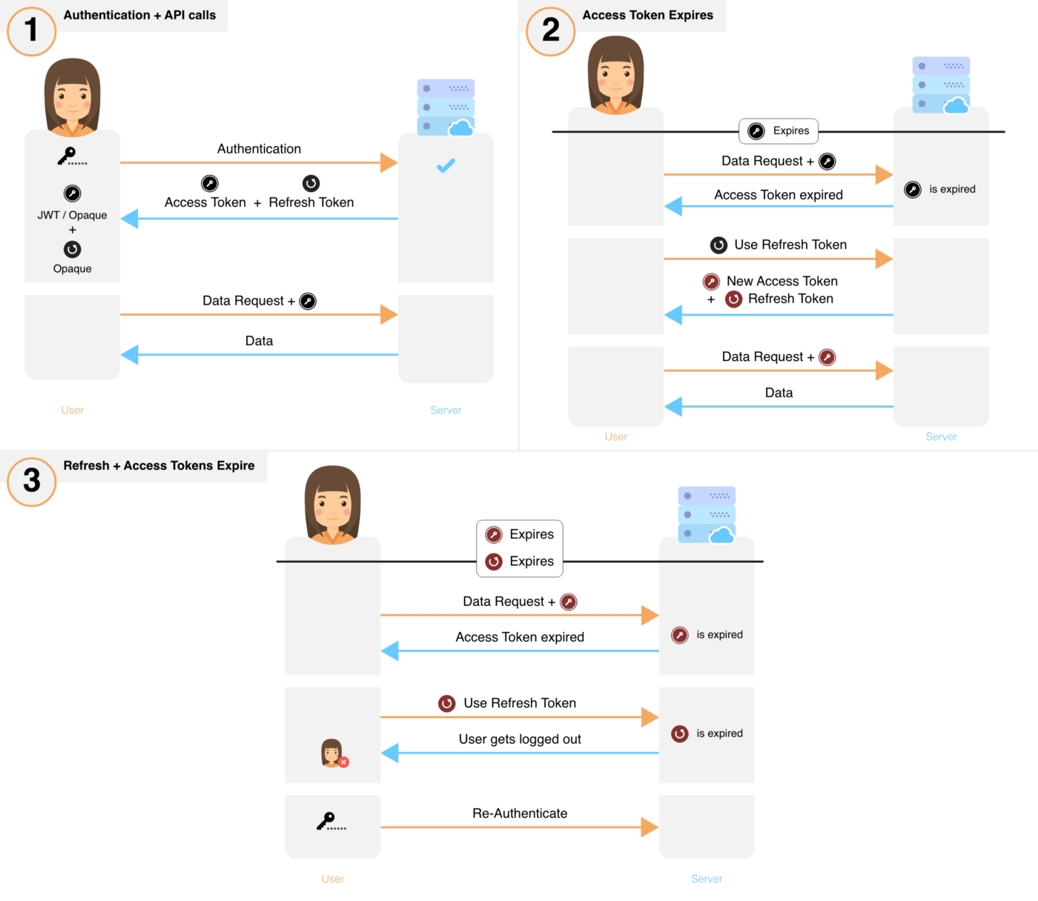
Rotate refresh tokens with short lived access tokens

Slide 2
Rotate refresh tokens with short lived access tokens
- Access tokens are short lived (15 min or less) and refresh tokens are long-lived (would be short live too if nedded).
- When a new refresh token is obtained, the old refresh an accesss tokens are invalidated on the backend and removed from the frontend.
- If the user voluntarily logs out, the access and refresh tokens are revoked and cleared from the frontend.

Slide 3
3.- Save new tokens.
Invalidate previous
tokens only when the
frontend uses the new
tokens (see REDIS *1)
Verify AT
1.- Already opened
session request
(expirated AT)
2.- Generate
AT and RT
Request
Success
Check RT
in blacklist
and verify it
Success
Fail
4.- Authorize
Request
4.- Ask for RT
Fail
Set RT and its AT in
Blacklist and logout
(see REDIS *2)
Authenticate
against DB
Verify RT
Success
Success
Theft Detection
Fail
REDIS
*1 - Generate Tokens - HASH:
KEY = refresh-token:<RT>
VALUE = access-token <AT> fingerprint <FP> previous-refresh-token <previousRT>
*2 - Blacklist - HASH:
KEY = tokens-blacklist
VALUE = <RT> <AT>
Logout and
invalidate associated
tokens If exists
(see REDIS *1)
Fail
1.- Authentication
Request

Slide 4
